Slide 1
The influence of metric proficiency on scientific literacy and acceptance of science
Alannah Mack¹, Anique Thompson¹, Kasha Price¹, Kofi Khamit-Kush² , Hong Qin¹
¹ Biology Department, Spelman College ² Psychology Department, Morehouse College, Atlanta, GA 30314, U.S.A.

Slide 2
Outline
Introduction
Methods
Results and Analysis
Conclusion

Slide 3
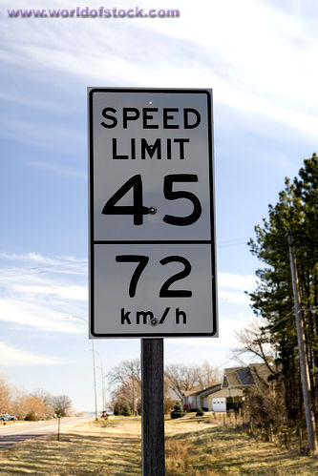
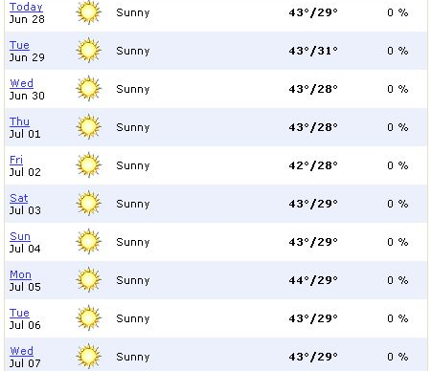
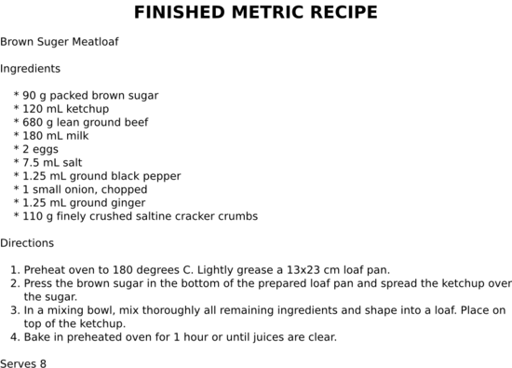

Slide 4
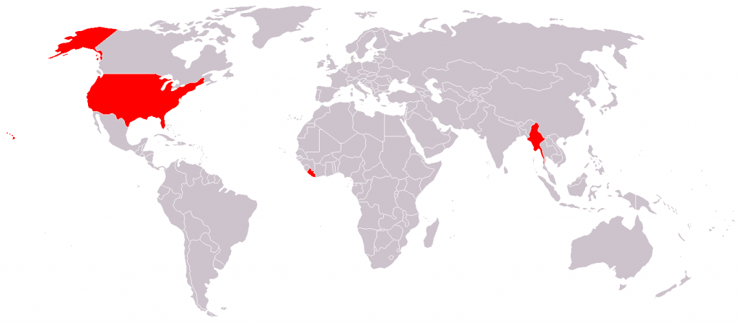
Background
The U.S. is one of three countries that does not employ the metric system.
As a result, Americans often have trouble understanding and relating the metric system to everyday life and experiences.
The metric system is the primary system of measurement in science.

Slide 5
Hypothesis
Does this partition of daily life and scientific understanding hinder the scientific literacy for the American population and impose a negative connotation on science as a whole?
Does one’s understanding of the metric system have an influence on her attitude towards and understanding of scientific concepts?

Slide 6
Methods
We designed a survey to gauge people’s scientific literacy and acceptance of scientific findings based on European survey.
The survey contains 3 sets of problems:
Proficiency of the metric system
Scientific literacy
Attitude and acceptance toward science

Slide 7
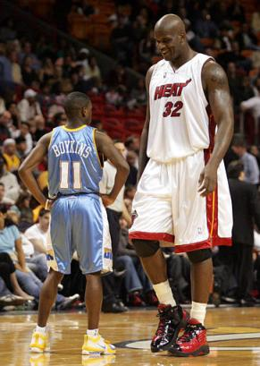

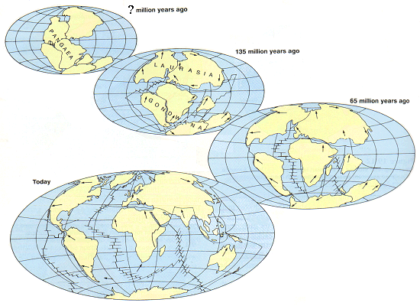

Slide 8
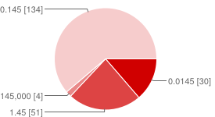
145mm = ___m
Results
Answer | Responses | Percentage
0.145 | 134 | 61%
1.45 | 30 | 23%
0.0145 | 51 | 14%
145,000 | 4 | 2%

Slide 9
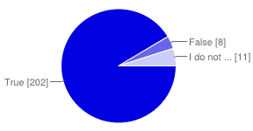
The center of the Earth is very hot.
Answer | Responses | Percentage
True | 202 | 91%
False | 8 | 5%
I don’t know. | 11 | 4%

Slide 10
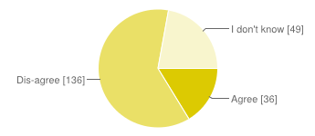
Do you agree that organic food should be DNA-free food?
Answer | Responses | Percentage
Agree | 36 | 16%
Dis-agree | 136 | 62%
I don’t know. | 49 | 22%

Slide 11
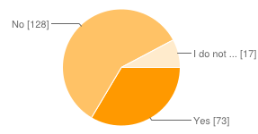
My religious views are more important than scientific views.
Answer | Responses | Percentage
Yes | 73 | 33%
No | 128 | 59%
I don’t know. | 17 | 8%

Slide 12
Analysis
Survey data was quantified.
Used linear regression to model trend relationship between scientific literacy and metric proficiency.
Correct Answer | 1
I don’t know | 0.5
Incorrect Answer | 0

Slide 13
Relationship between metric proficiency and scientific literacy

Slide 14
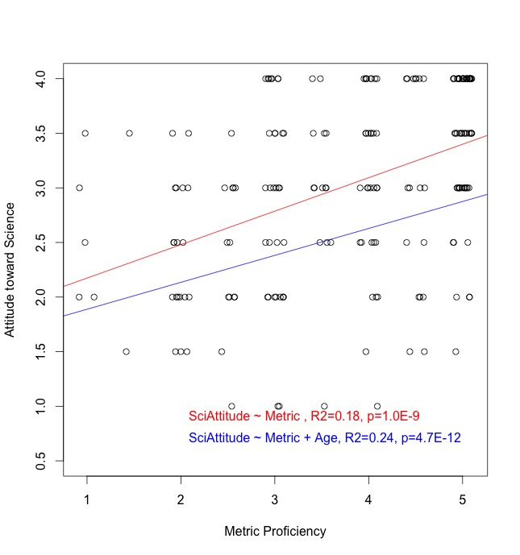
Relationship between metric proficiency and attitude towards science

Slide 15
Conclusion
Metric Proficiency
Scientific Literacy
Attitude toward Science

Slide 16
References
Champagne, A. Newell, S. Directions for research and development: alternative methods of assessing scientific literacy. Journal of Research in Science Teaching, 29 (8), 1992.
Impey, C., Buxner, S., Antonellis, J. Johnson, E., King, C., A twenty-year survey of science literacy among college undergraduates. Journal of College Science Teaching, 40 (4), 2011.
Delgado, Cesar. Units of length: a notational system for conceptual understanding of size and scale. Proceedings of the 9th International Conference of the Learning Sciences. 2010.
Evans, G. Durant, J. The relationship between knowledge and attitudes in the public understanding of science in Britain. Public Understanding of Science, 4 (1). 1995.

Slide 17
Sources of Figures
http://chanadbahraini.blogspot.com/2004_06_01_archive.html
http://www.wikihow.com/Convert-Your-Recipe-to-Metric-and-Use-Weights-Instead-of-Volume

